Slide 1

Introduction to React-BootStrap

Slide 2
Objectives
What is React-Bootstrap?
Why use React-Bootstrap?
Features and aspects of React-Bootstrap
Installation and Configuration of React-Bootstrap
Grid, Layout of React-Bootstrap
Basic Components of React-Bootstrap: Button, Checkbox, Listbox, Navigation(Navbars, Navs, Tabs), Modal, Alert, Card,…
Controlled and UnControlled

Slide 3
What is React-Bootstrap?
React-Bootstrap is a popular open-source library that provides a set of Bootstrap components as reusable React components.
It combines the flexibility and power of the Bootstrap framework with the dynamic nature of React
Making it easier for developers to build responsive and feature-rich web applications with a modern design.

Slide 4
Why use React-BootStrap?
Since React-Bootstrap is built with React Javascript, state can be passed within React-Bootstrap components as a prop.
It also makes it easier to manage the state as updates are made using React’s state instead of directly manipulating the state of the DOM.
This also gives a lot of flexibility when creating more complex components.

Slide 5
Features and aspects of React-Bootstrap
Component-Based
Responsive Design
Easy Customization
Integration with React
Rich Component Library
Community and Support
Consistent Design
Faster Development
Cross-Browser Compatibility
Updates and Maintenance

Slide 6
Installation and Configuration of React-Bootstrap
Install React-Bootstrap: npm install react-bootstrap bootstrap
Import Bootstrap CSS: import 'bootstrap/dist/css/bootstrap.min.css’;
Import React-Bootstrap Components import Button from 'react-bootstrap/Button’;
Use React-Bootstrap Components:
render() {
return (
<div>
<Button variant="primary">Primary Button</Button>
</div>
);
}

Slide 7
Grid System
https://react-bootstrap.netlify.app/docs/layout/grid
React-Bootstrap utilizes Bootstrap's grid system to create responsive layouts.
You can use components like Container, Row, and Col to structure your content within a grid.
Container
Fluid Container
import Container from 'react-bootstrap/Container';
import Row from 'react-bootstrap/Row';
import Col from 'react-bootstrap/Col';
function ContainerExample() {
return (
<Container>
<Row>
<Col>1 of 1</Col>
</Row>
</Container>
);
}
export default ContainerExample;
import Container from 'react-bootstrap/Container';
import Row from 'react-bootstrap/Row';
import Col from 'react-bootstrap/Col';
function ContainerFluidExample() {
return (
<Container fluid>
<Row>
<Col>1 of 1</Col>
</Row>
</Container>
);
}
export default ContainerFluidExample;

Slide 8
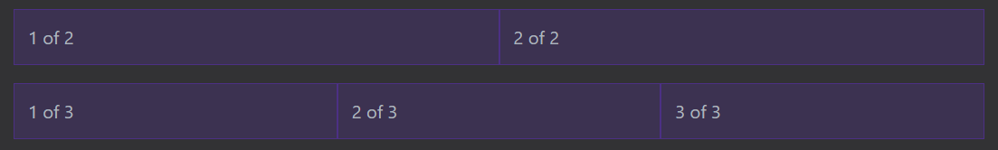
Auto-layout columns
When no column widths are specified the Col component will render equal width columns
function AutoLayoutExample() {
return (
<Container>
<Row>
<Col>1 of 2</Col>
<Col>2 of 2</Col>
</Row>
<Row>
<Col>1 of 3</Col>
<Col>2 of 3</Col>
<Col>3 of 3</Col>
</Row>
</Container>
);
}
export default AutoLayoutExample;

Slide 9
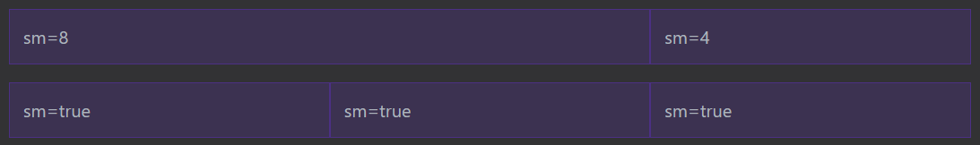
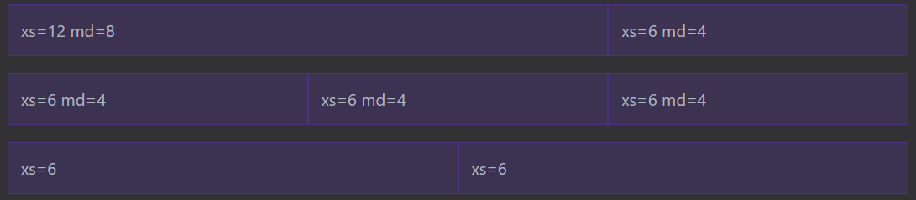
Responsive grids
The Col lets you specify column widths across 6 breakpoint sizes (xs, sm, md, lg, xl and xxl).
For every breakpoint, you can specify the amount of columns to span, or set the prop to <Col lg={true} /> for auto layout widths.
function ResponsiveAutoExample() {
return (
<Container>
<Row>
<Col sm={8}>sm=8</Col>
<Col sm={4}>sm=4</Col>
</Row>
<Row>
<Col sm>sm=true</Col>
<Col sm>sm=true</Col>
<Col sm>sm=true</Col>
</Row>
</Container>
);
}
export default ResponsiveAutoExample;
Can also mix and match breakpoints to create different grids depending on the screen size.

Slide 10
Buttons
https://react-bootstrap.netlify.app/docs/components/buttons
Use Bootstrap’s custom button styles for actions in forms, dialogs, and more with support for multiple sizes, states, and more.
Use any of the available button style types to quickly create a styled button. Just modify the variant prop.
function TypesExample() {
return (
<>
<Button variant="primary">Primary</Button>{' '}
<Button variant="secondary">Secondary</Button>{' '}
<Button variant="success">Success</Button>{' '}
<Button variant="warning">Warning</Button>{' '}
<Button variant="danger">Danger</Button>{' '}
<Button variant="info">Info</Button>{' '}
<Button variant="light">Light</Button>{' '}
<Button variant="dark">Dark</Button>
<Button variant="link">Link</Button>
</>
);
}
export default TypesExample;

Slide 11


Button loading state
import { useEffect, useState } from 'react';
import Button from 'react-bootstrap/Button';
function LoadingButton() {
const [isLoading, setLoading] = useState(false);
useEffect(() => {
function simulateNetworkRequest() {
return new Promise((resolve) => setTimeout(resolve, 2000));
}
if (isLoading) {
simulateNetworkRequest().then(() => {
setLoading(false);
});
}
}, [isLoading]);
const handleClick = () => setLoading(true);
return (
<Button
variant="primary"
disabled={isLoading}
onClick={!isLoading ? handleClick : null}
>
{isLoading ? 'Loading…' : 'Click to load'}
</Button>
);
}
export default LoadingButton;
When activating an asynchronous action from a button it is a good UX pattern to give the user feedback as to the loading state, this can easily be done by updating <Button /> props from a state change like below.

Slide 12
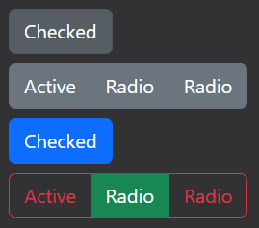
Checkbox / Radio
import Button from 'react-bootstrap/Button'; import { useState } from 'react';
import ButtonGroup from 'react-bootstrap/ButtonGroup';
import ToggleButton from 'react-bootstrap/ToggleButton';
function ToggleButtonExample() {
const [checked, setChecked] = useState(false);
const [radioValue, setRadioValue] = useState('1');
const radios = [
{ name: 'Active', value: '1' },
{ name: 'Radio', value: '2' },
{ name: 'Radio', value: '3' },
];
return (
<> //Button Types
</>
);
}
export default ToggleButtonExample;
Buttons can also be used to style checkbox and radio form elements. This is helpful when you want a toggle button that works neatly inside an HTML form.
<ButtonGroup className="mb-2">
<ToggleButton
id="toggle-check"
type="checkbox"
variant="secondary"
checked={checked}
value="1"
onChange={(e) => setChecked(e.currentTarget.checked)}
>
Checked
</ToggleButton>
</ButtonGroup>

Slide 13
Checkbox / Radio
<ButtonGroup className="mb-2">
{radios.map((radio, idx) => (
<ToggleButton
key={idx}
id={`radio-${idx}`}
type="radio"
variant="secondary"
name="radio"
value={radio.value}
checked={radioValue === radio.value}
onChange={(e) => setRadioValue(e.currentTarget.value)}
>
{radio.name}
</ToggleButton>
))}
</ButtonGroup>
<ToggleButton
className="mb-2"
id="toggle-check"
type="checkbox"
variant="outline-primary"
checked={checked}
value="1"
onChange={(e) => setChecked(e.currentTarget.checked)}
>
Checked
</ToggleButton>
<ButtonGroup>
{radios.map((radio, idx) => (
<ToggleButton
key={idx}
id={`radio-${idx}`}
type="radio"
variant={idx % 2 ? 'outline-success' : 'outline-danger'}
name="radio"
value={radio.value}
checked={radioValue === radio.value}
onChange={(e) => setRadioValue(e.currentTarget.value)}
>
{radio.name}
</ToggleButton>
))}
</ButtonGroup>

Slide 14
UnControlled vs Controlled
import ToggleButton from 'react-bootstrap/ToggleButton';
import ToggleButtonGroup from 'react-bootstrap/ToggleButtonGroup'; function ToggleButtonGroupUncontrolled() {
return (
<>
<ToggleButtonGroup type="checkbox" defaultValue={[1, 2]} className="mb-2">
<ToggleButton id="tbg-check-1" value={1}>
Checkbox 1 (pre-checked)
</ToggleButton>
<ToggleButton id="tbg-check-2" value={2}>
Checkbox 2
</ToggleButton>
</ToggleButtonGroup>
<ToggleButtonGroup type="radio" name="options" defaultValue={1}>
<ToggleButton id="tbg-radio-1" value={1}>
Radio 1 (pre-checked)
</ToggleButton>
<ToggleButton id="tbg-radio-2" value={2}>
Radio 2
</ToggleButton>
</ToggleButtonGroup>
</>
);
}
export default ToggleButtonGroupUncontrolled;
import { useState } from 'react';
import ToggleButton from 'react-bootstrap/ToggleButton';
import ToggleButtonGroup from 'react-bootstrap/ToggleButtonGroup';
function ToggleButtonGroupControlled() {
const [value, setValue] = useState([1, 3]);
const handleChange = (val) => setValue(val);
return (
<ToggleButtonGroup type="checkbox" value={value} onChange={handleChange}>
<ToggleButton id="tbg-btn-1" value={1}>
Option 1
</ToggleButton>
<ToggleButton id="tbg-btn-2" value={2}>
Option 2
</ToggleButton>
<ToggleButton id="tbg-btn-3" value={3}>
Option 3
</ToggleButton>
</ToggleButtonGroup>
);
}
export default ToggleButtonGroupControlled;

Slide 15
Navigation
React-Bootstrap helps in creating navigation bars and menus.
Components like Navbar, Nav, NavDropdown, and Nav.Item are available for building navigation structures.
Navbars:
Use the expand prop to allow for collapsing the Navbar at lower breakpoints.
Navbars and their contents are fluid by default. Use optional containers to limit their horizontal width.
Use spacing and flex utilities to size and position content
Navs and tabs:
Navs: The base Nav component is built with flexbox and provide a strong foundation for building all types of navigation components.
Tabs: Visually represent nav items as "tabs". This style pairs nicely with tabbable regions created by our Tab components.

Slide 16

Navbars
import Container from 'react-bootstrap/Container';
import Nav from 'react-bootstrap/Nav';
import Navbar from 'react-bootstrap/Navbar';
import NavDropdown from 'react-bootstrap/NavDropdown';
function BasicExample() {
return (
<Navbar expand="lg" className="bg-body-tertiary">
<Container>
<Navbar.Brand href="#home">React-Bootstrap</Navbar.Brand>
<Navbar.Toggle aria-controls="basic-navbar-nav" />
<Navbar.Collapse id="basic-navbar-nav">
<Nav className="me-auto">
<Nav.Link href="#home">Home</Nav.Link>
<Nav.Link href="#link">Link</Nav.Link>
<NavDropdown title="Dropdown" id="basic-nav-dropdown">
<NavDropdown.Item href="#action/3.1">Action</NavDropdown.Item>
<NavDropdown.Item href="#action/3.2">
Another action
</NavDropdown.Item>
<NavDropdown.Item href="#action/3.3">Something</NavDropdown.Item>
<NavDropdown.Divider />
<NavDropdown.Item href="#action/3.4">
Separated link
</NavDropdown.Item>
</NavDropdown>
</Nav>
</Navbar.Collapse>
</Container>
</Navbar>
);
}
export default BasicExample;
A responsive navigation header, including support for branding, navigation, and more.
Here’s an example of all the sub-components included in a responsive light-themed navbar that automatically collapses at the lg (large) breakpoint.
https://react-bootstrap.netlify.app/docs/components/navbar

Slide 17

Navs
import Nav from 'react-bootstrap/Nav';
function BasicExample() {
return (
<Nav
activeKey="/home"
onSelect={(selectedKey) => alert(`selected ${selectedKey}`)}
>
<Nav.Item>
<Nav.Link href="/home">Active</Nav.Link>
</Nav.Item>
<Nav.Item>
<Nav.Link eventKey="link-1">Link</Nav.Link>
</Nav.Item>
<Nav.Item>
<Nav.Link eventKey="link-2">Link</Nav.Link>
</Nav.Item>
<Nav.Item>
<Nav.Link eventKey="disabled" disabled>
Disabled
</Nav.Link>
</Nav.Item>
</Nav>
);
}
export default BasicExample;
<Nav> markup is very flexible and styling is controlled via classes.
By default <Nav> and <Nav.Item> both render <div> instead of <ul> and <li> elements respectively. This because it's possible (and common) to leave off the <Nav.Item>'s and render a <Nav.Link> directly, which would create invalid markup by default (ul > a).
When a <ul> is appropriate you can render one via the as prop; be sure to also set your items to <li> as well!

Slide 18

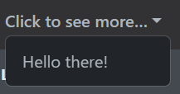


Tabs
https://react-bootstrap.netlify.app/docs/components/navs/
Create a vertical nav (.flex-column) with tabs styling is unsupported by Bootstrap's default stylesheet.

Slide 19
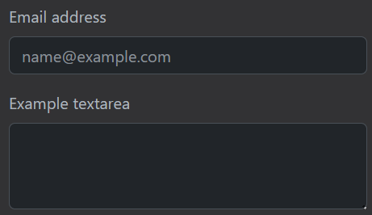
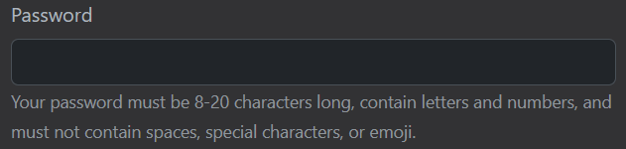
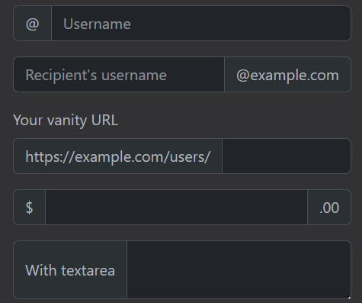




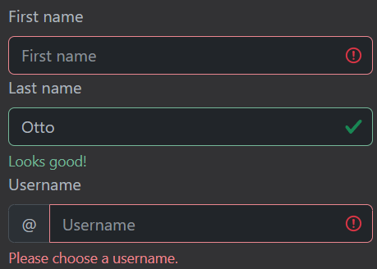

Features of Forms
Form controls
Form text
Select
Checks and radios
Range
Input Group
Floating labels
Validation
https://react-bootstrap.netlify.app/docs/forms/form-control

Slide 20
Modals
Modals are positioned over everything else in the document and remove scroll from the <body> so that modal content scrolls instead.
Modals are unmounted when closed.
Bootstrap only supports one modal window at a time. Nested modals aren't supported, but if you really need them, the underlying @restart/ui library can support them if you're willing.
Modal's "trap" focus in them, ensuring the keyboard navigation cycles through the modal, and not the rest of the page.
Unlike vanilla Bootstrap, autoFocus works in Modals because React handles the implementation.

Slide 21
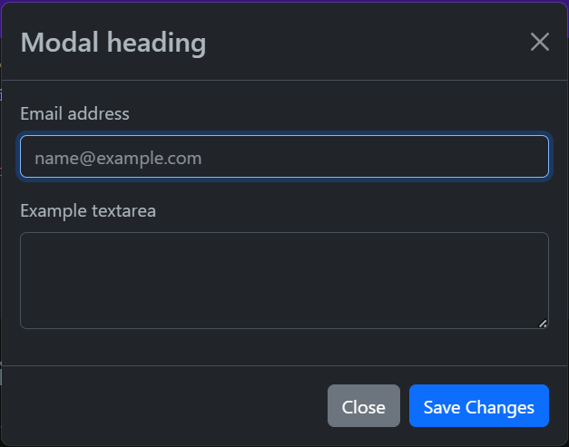
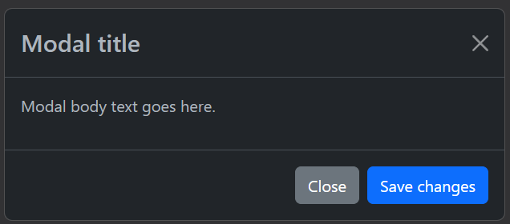
Modals – cont’d
https://react-bootstrap.netlify.app/docs/components/modal

Slide 22
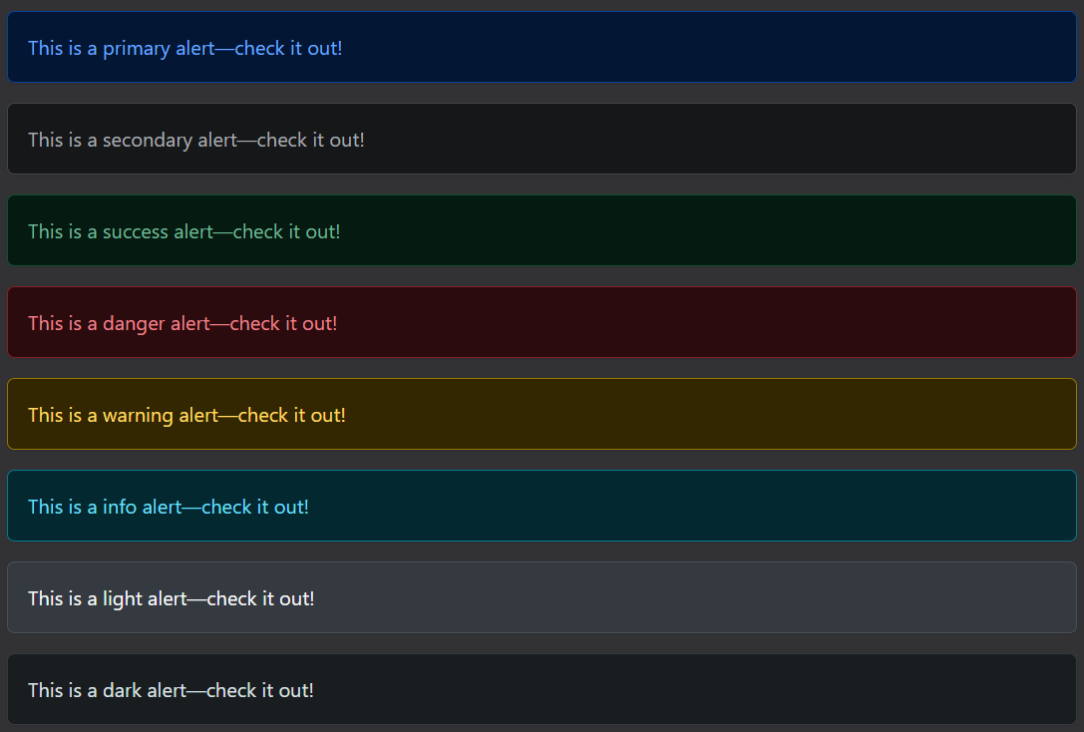
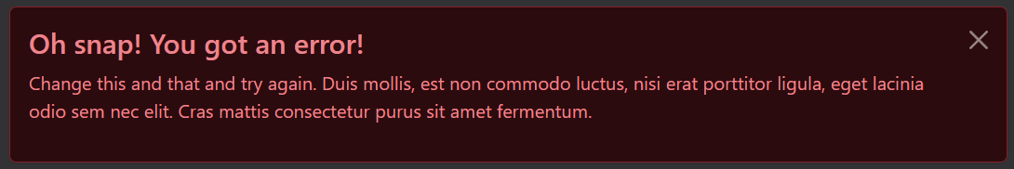
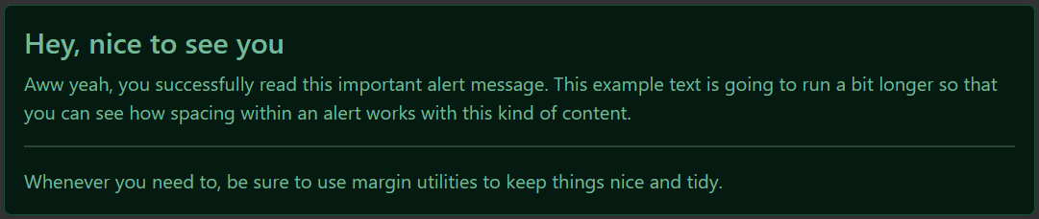
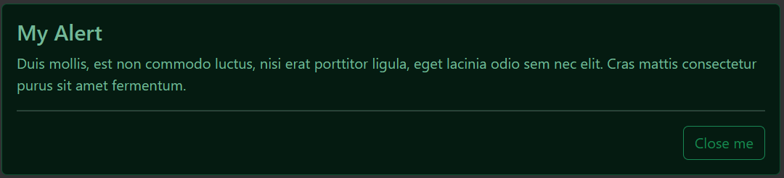
Alerts
https://react-bootstrap.netlify.app/docs/components/alerts
Provide contextual feedback messages for typical user actions with the handful of available and flexible alert messages.

Slide 23
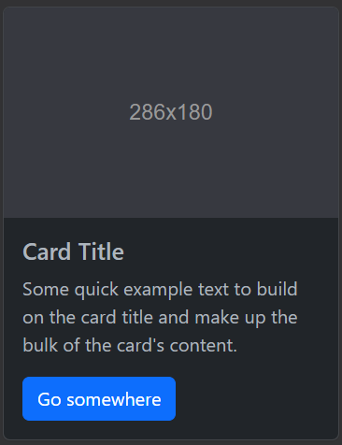
Cards
https://react-bootstrap.netlify.app/docs/components/cards
Bootstrap’s cards provide a flexible and extensible content container with multiple variants and options.
import Button from 'react-bootstrap/Button';
import Card from 'react-bootstrap/Card';
function BasicExample() {
return (
<Card style={{ width: '18rem' }}>
<Card.Img variant="top" src="holder.js/100px180" />
<Card.Body>
<Card.Title>Card Title</Card.Title>
<Card.Text>
Some quick example text to build on the card title and make up the
bulk of the card's content.
</Card.Text>
<Button variant="primary">Go somewhere</Button>
</Card.Body>
</Card>
);
}
export default BasicExample;

Slide 24
Exercise 10: Demo about React-BootStrap

Slide 25
Summary
Concepts were introduced:
What is React-Bootstrap?
Why use React-Bootstrap?
Features and aspects of React-Bootstrap
Installation and Configuration of React-Bootstrap
Grid, Layout of React-Bootstrap
Basic Components of React-Bootstrap: Button, Checkbox, Listbox, Navigation(Navbars, Navs, Tabs), Modal, Alert, Card,…
Controlled and UnControlled

